Slide 1

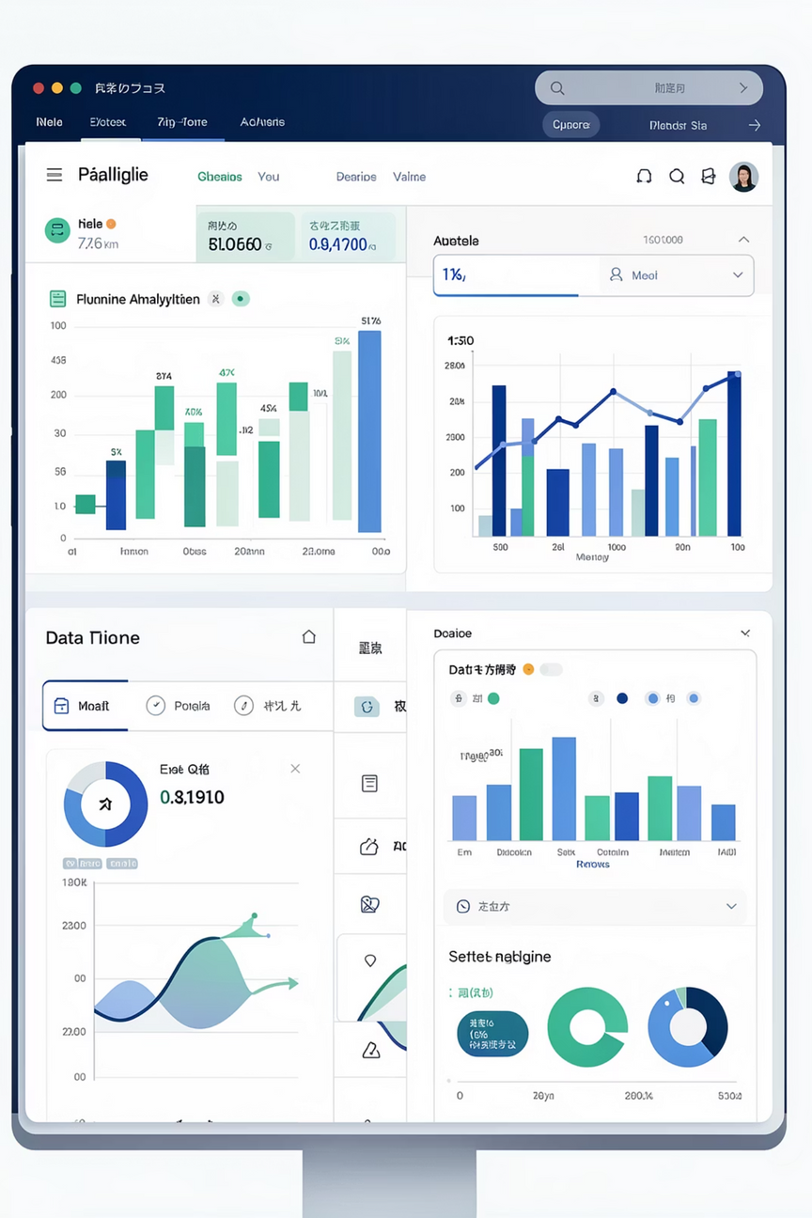
Real-Time Data Engineering Framework for Business Intelligence
Open-Source Based Implementation
Software Group Project
Team Members: Vansh Mehta, Dax Virani
Notes:
1

Slide 2
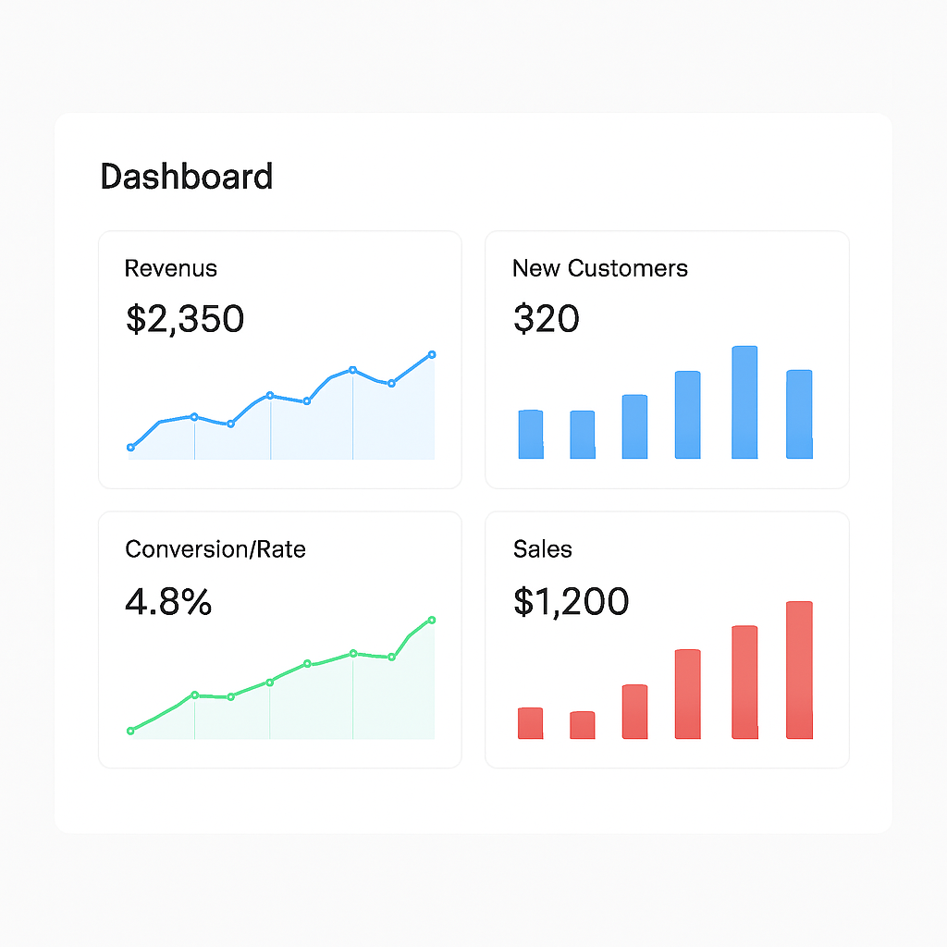
Problem Statement
Current Limitations in Business Intelligence
Traditional batch-based BI systems create significant operational challenges for modern enterprises requiring immediate insights:
Delayed insights: Batch processing introduces hours or days of latency between data generation and analysis
Limited visibility: Absence of real-time visibility into critical business metrics impedes timely decision-making
Reactive operations: Organizations cannot respond proactively to emerging issues or opportunities
Competitive disadvantage: Inability to process streaming data limits responsiveness to market changes
Notes:
2

Slide 3
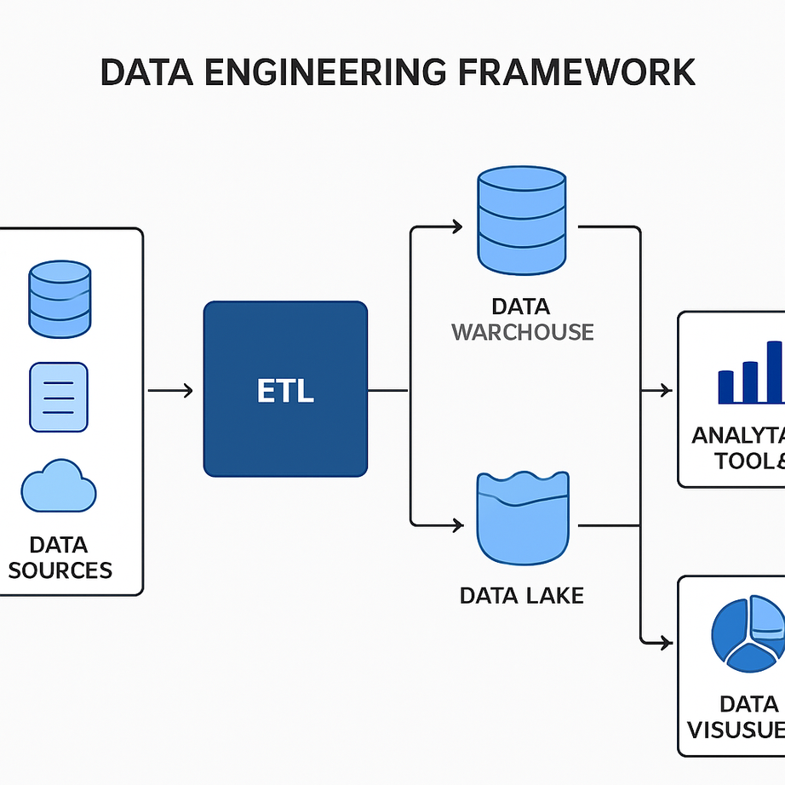



Project Overview
Real-Time Framework
Unified Architecture
Open-source data engineering framework enabling continuous data ingestion, processing, and analytics with minimal latency
Integrated solution supporting both real-time streaming and historical batch analytics within a single infrastructure
Business Intelligence
Live dashboards providing stakeholders with immediate visibility into operational metrics and KPIs
Notes:
3

Slide 4
Project Objectives
01
02
Multi-Source Data Ingestion
Low-Latency Stream Processing
Implement real-time data collection from diverse sources including transactional systems, application logs, IoT sensors, and event streams
Process streaming data with sub-second latency using distributed computing frameworks and optimized transformation pipelines
03
04
Scalable Data Storage
Interactive Analytics Interface
Design fault-tolerant storage layer capable of handling high-throughput data ingestion while maintaining data integrity and accessibility
Deploy live dashboards with configurable alerts and visualizations enabling stakeholders to monitor business metrics in real-time
Notes:
4

Slide 5






System Architecture & Design Blueprint
Data Sources
Simulated events, application logs, transaction streams, API endpoints
Apache Kafka
Real-time message queuing and distributed streaming platform for data ingestion
Apache Spark
Structured Streaming for real-time data processing and transformation
Storage Layer
PostgreSQL for relational data, HDFS for raw data archival
Apache Superset
Interactive BI dashboard for visualization and analytics
Monitoring Stack
Logging, performance metrics, and system health monitoring
Notes:
5

Slide 6
Technology Stack
Open-Source Components
Programming Language
Stream Processing
Data Storage
Python 3.x for development and scripting
Apache Kafka for message brokering and Apache Spark Structured Streaming for computation
PostgreSQL for structured data persistence, HDFS for distributed file storage
Visualization
Infrastructure
Apache Superset for BI dashboards, optionally Grafana for infrastructure monitoring
Containerized deployment using Docker, local cluster or cloud-based infrastructure
Notes:
6

Slide 7






Module-Wise Implementation Plan
Module 1: Data Source Simulation
Develop event generators producing realistic business data patterns including sales transactions, user activity logs, and system metrics
Module 2: Real-Time Ingestion
Implement Kafka producers and consumers for reliable message passing with proper serialization and topic management
Module 3: Stream Processing
Build Spark streaming pipelines for data transformation, aggregation, and enrichment with windowing operations
Module 4: Data Storage
Configure PostgreSQL schemas for analytical queries and HDFS for raw data archival with appropriate partitioning
Module 5: BI Dashboard
Design interactive dashboards with configurable visualizations, drill-down capabilities, and scheduled report generation
Module 6: Monitoring
Deploy logging infrastructure, performance monitoring, and alerting systems for production readiness
Notes:
7

Slide 8
3-Month Timeline & Milestones
Month 1: Foundation
Month 3: Integration & Optimization
Week 1-2: Problem analysis, literature review, architecture design
Week 1-2: BI dashboard development, visualization components
Week 3-4: Technology evaluation, environment setup, initial Kafka implementation
Week 3-4: System integration, performance testing, documentation
1
2
3
Month 2: Core Development
Week 1-2: Spark streaming integration, data transformation logic
Week 3-4: Storage layer implementation, data persistence mechanisms
Key Deliverables
Architecture design document
Working data pipeline prototype
Integrated BI dashboard
Performance evaluation report
Notes:
8

Slide 9

Project Team & Roles
Vansh Mehta: Data Engineering Lead
Dax Virani: Analytics & BI Lead
System architecture design
Real-time data ingestion (Apache Kafka)
Stream processing (Apache Spark Structured Streaming)
Data cleansing, transformation, and aggregation
Pipeline performance and fault tolerance
Data storage schema design (PostgreSQL / HDFS)
KPI definition and business metrics
BI dashboard development (Apache Superset / Grafana)
Real-time data visualization and insights
Monitoring, logging, and performance analysis
Notes:
9

Slide 10
Expected Outcomes & Conclusion
Functional Real-Time BI System
Scalable Data Pipeline
Academic Deliverables
Complete open-source implementation demonstrating real-time data processing from ingestion through visualization with documented source code and architecture
Low-latency, fault-tolerant architecture capable of horizontal scaling with measured performance benchmarks and optimization recommendations
Comprehensive project report, technical documentation, test results, and presentation materials suitable for academic evaluation and defense
Technical Strengths
Industry Relevance
Open-source technology stack ensuring reproducibility
Real-time processing with measurable latency metrics
Modular architecture supporting future enhancements
Cost-effective solution for SMBs
Modern data engineering practices
Skills transferable to production environments
Project readiness: Architecture validated through proof-of-concept testing, technology stack evaluated for 3-month feasibility, and milestone-based deliverables aligned with academic evaluation criteria.
Notes:
10

